Slide 1
Intel IoT Developer Products and Program Accelerating IoT Solution Design and Deployment
Developer Relations Division, Intel®

Slide 2
Legal Notices and Disclaimers
Intel technologies’ features and benefits depend on system configuration and may require enabled hardware, software or service activation. Performance varies depending on system configuration. No computer system can be absolutely secure. Check with your system manufacturer or retailer or learn more at www.intel.com.
This document contains information on products, services and/or processes in development. All information provided here is subject to change without notice. Contact your Intel representative to obtain the latest forecast, schedule, specifications and roadmaps.
Any forecasts of goods and services needed for Intel’s operations are provided for discussion purposes only. Intel will have no liability to make any purchase in connection with forecasts published in this document.
ARDUINO 101 and the ARDUINO infinity logo are trademarks or registered trademarks of Arduino, LLC.
Intel, the Intel logo, Intel Inside, the Intel Inside logo, OpenVINO, Intel Atom, Celeron, Intel Core, and Intel Movidius Myriad 2 are trademarks of Intel Corporation or its subsidiaries in the U.S. and/or other countries.
*Other names and brands may be claimed as the property of others.
Copyright 2018 Intel Corporation.
2

Slide 3
Enabling New Developer Opportunities
ACCESS TO KNOWLEDGE
ACCELERATED PROTOTYPING
DEFINE
What Intel Brings
OPTIMIZE
Common and seamless Developer experience
Start to finish technologies for robust solutions
Simplified path to develop and deploy products, systems, solutions
Reusability, extensibility, portability, future proof
The Developer’s Journey
Technology
EVALUATE
STREAMLINED
DEVELOPMENT
Developer Experience
Future Trends
DEVELOP
POWERFUL FOUNDATION OF IOT INGREDIENTS
MANAGE
DEPLOY
FAST DEPLOYMENTS
Real world start to finish relevant technologies for robust solutions
Simplified path to develop and deploy products, systems, solutions
Reusability, extensibility, portability
Notes:
Key Message: Intel creates new opportunities in the IoT developer journey, by leveraging deep understanding of IoT, in-house design/development expertise, silicon and software products, and strong ecosystem relationships to accelerate IoT architecting, development, and deployment.
Time is of the essence for IoT developers. Learning, evaluating, selecting, prototyping, and integrating takes time that the developer cannot afford in order to stay competitive.
Intel is working to accelerate and simplify the IoT developer experience in order to speed time to proofs of concept and help bring solutions to market faster that are designed to meet customer needs over long-term deployments.
From definition through evaluation of ingredients, technologies, and architectures, Intel offers tools, technologies, and proven developer kits with amazing out-of-box experiences to get you prototyping quickly.
Intel’s enablement in the developer journey is driven by our developer program that requires tools to be useful and proven, provide multiple points of entry along the developer journey, and designed to deliver more than just functionality. For our kits and tools, we provide documentation, a web portal, API references, robust code samples and tutorials, and paths to integration.

Slide 4
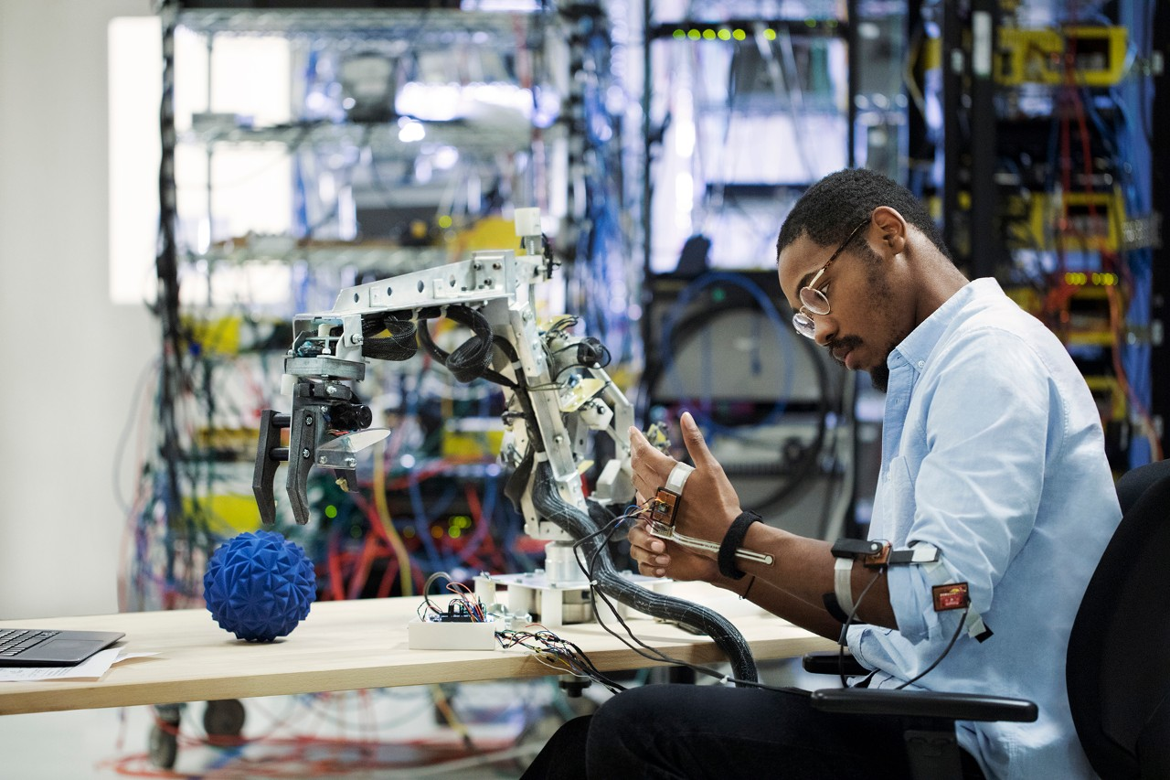
Delivering a Unified, Seamless IoT Developer Experience
DEEP INVESTMENT
in understanding, addressing IoT developer challenges
ACCELERATING
the development process
AMAZING
out-of-box experiences
simplified
for ease of use, consistency, and compatibility
Notes:
Key Message: Intel’s investment in the IoT developer experience to simplify and accelerate the journey.
The IoT solution architect and developer integrate across multiple technologies, devices and drivers, software, silicon, and form factors to create robust, scalable solutions at the edge. They face many challenges due to the volume, variety, and velocity of data being generated, security and protection requirements, costs to move data, and other issues as they are under pressure to deliver innovative solutions to stay competitive.
Intel has invested deeply over the years to help solve IoT developer challenges in order to accelerate the development and deployment processes. This has resulted in creating purpose-built silicon, IDEs, software tools—such as software development kits, libraries, optimized AI frameworks, and sample code—along with reference designs, support, and other resources to accelerate development of scalable solution designs on the rich and diverse portfolio of Intel silicon. Working through its strong ecosystem relationships, Intel has brought many of these resources into fully supported developer kits with proven out-of-box experiences to help make the journey from architecting to prototype smooth and seamless.
Working with a diverse and capable ecosystem to supply the kits allows fast migration from development to deployment of solutions that support applications for today and the future.
The kits offer amazing out-of-box experiences that were tested with developers across various service providers. Often, developers were up and running, creating solutions from sample code in 30 minutes or less. The developer kits are readily available from various ecosystem partners to get you started immediately creating innovative IoT solutions.
Intel’s investment in supporting and enabling IoT developers creates a unified and seamless experience as they work across a vast design domain.

Slide 5
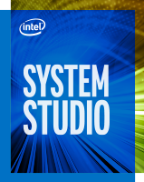
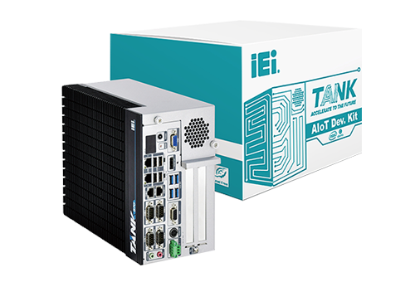
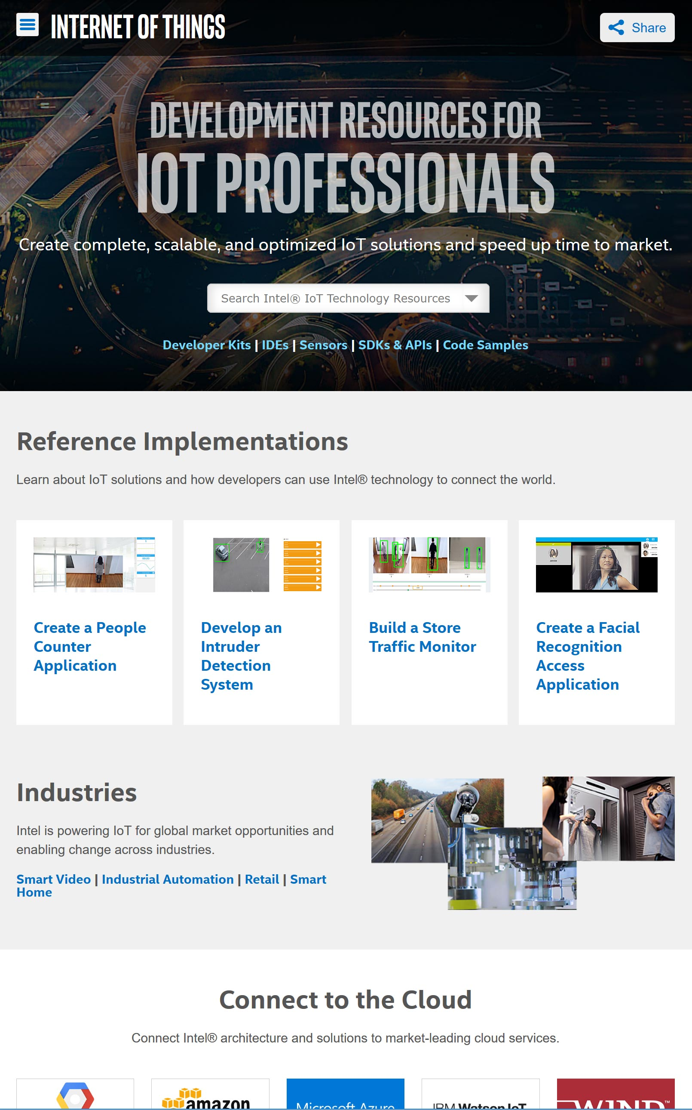
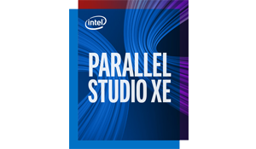
Comprehensive portfolio of developer resources
ToolS
Hardware
SDKS
INTEL DEVELOPER ZONE
OpenVINO™ Toolkit
Intel® Edge Insights Software
Intel® Media SDK and
Intel® Media Server Studio
Intel® SDK for OpenCL™ Applications
Intel® Active Management
Technology (AMT)
Notes:
Key Message: Describe the comprehensive range of offerings to help accelreate IoT development and deployment.
Flexibility of kits and software.
Portfolio of kits available from Intel.
Message to ODM – you too can be a kit providers.
Message to OEM – you have choices to accelerate your developer journey.
Intel has created a rich environment to accelerate design and deployment of scalable IoT solutions with choices of Integrated Development Environments for both prototyping and production deployment, developer kits with all the needed resources to quickly start creating and innovating on Intel silicon, software development kits for optimizing code and speeding the coding process, and a focused portal where you can interact with experts and peers to get answers you need.
By bringing together these critical resources and tools, you can focus on innovative solutions and your designs instead of building, troubleshooting, and validating a workable environment that lets you effectively compete in a growing market.

Slide 6
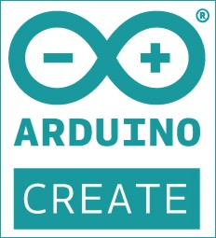
Fast Prototyping and Rich Optimization with Choice of Tools
Rapid Prototyping
Cloud-Based developer environment
Easy Out of Box Experience
Supports Intel based platforms running Linux
For Production and Performance Optimization
Easy Migration From Arduino Create*
Integrates Analyzers and Debug Tools
Leverages Sample Codes in the Kit
Notes:
Key Message: Choice of IDEs to match the prototyping and development needs.
One IDE does not fit all developers and environments. So, the Intel developer kits offer you choices.
You can quickly prototype in the cloud with Arduino Create* and then optimize your solution with Intel® System Studio. Or start with Intel System Studio and immediately take advantage of the powerful coding resources in Intel’s IDE. And, if you prototype with Arduino Create, there is an easy and fast migration process to bring your code into Intel System Studio without time consuming recoding and cleanup.
Arduino Create allows fast and easy prototyping in the cloud using Intel silicon. There’s probably no faster environment to begin your solution prototyping. The platform and the developer kit provide all the resources to get you prototyping and testing your ideas immediately instead of building your environment. Once you’ve proven your design, you can easily take your code into Intel System Studio.
Intel System Studio is an all-in-one, cross-platform, comprehensive tool suite for IoT device application development. It helps system engineers and developers shorten the development cycle so products can be brought to market faster, boost performance and power efficiency, and strengthen reliability for intelligent systems and IoT device applications running on Intel® processor-based platforms.

Slide 7
IEI* Tank AIOT Developer Kit
High-performance computer vision Applications
Industrialized Design
Intel® Core™ or Intel® Xeon™ Spec.
Extendible with PCIe* AI Accelerators
Preloaded with the Intel® Distribution of OpenVINO™ toolkit

Slide 8
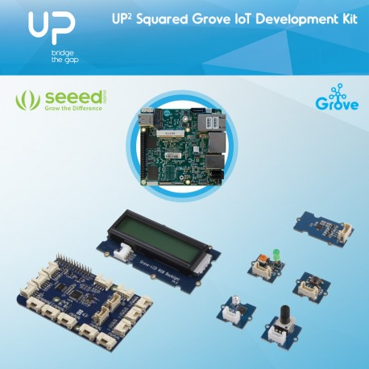
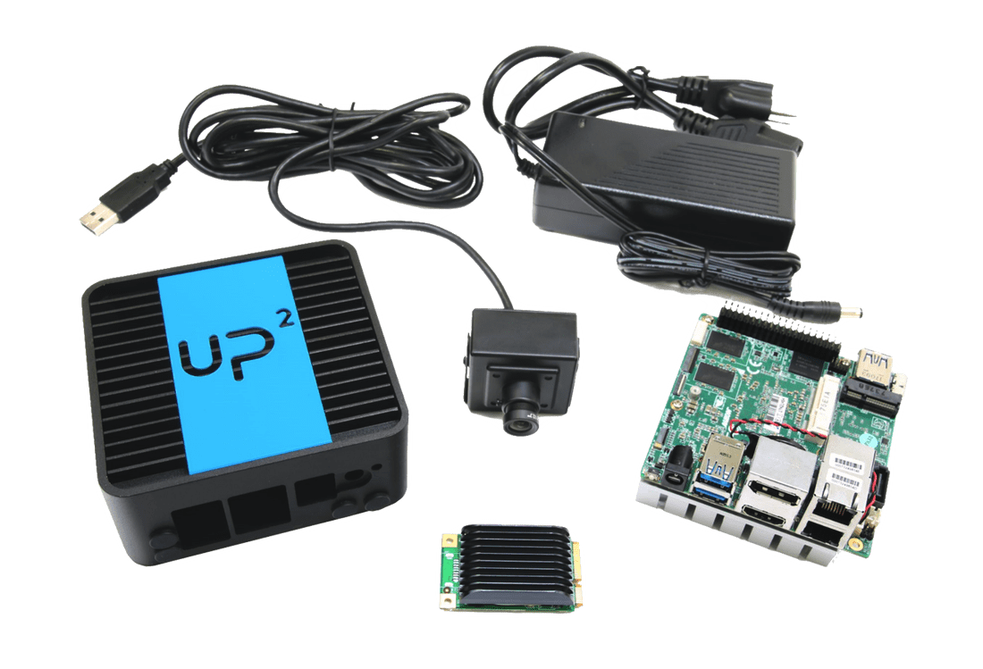
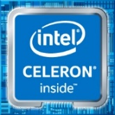
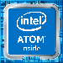
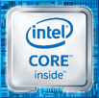
Developer Kits Accelerate Design of Innovative Solutions
UP2 grove IoT development Kit
UP2 AI Vision development Kit
iEi TANK aIot Development Kit
Versatile, broad prototype application
Traditional computer vision – Non-inference based training/learning
Basic essential components
Light computer vision/deep learning applications (1-2 cameras)
Conceptualization and early CV prototype development
Optional accelerator options
Demanding computer vision/deep learning applications (multi-camera environments)
Commercial production ready development
Built-in scaled support for complex/parallel video streams
Reduced time to prototype, expedite path to productization, and designed for scalability and extensibility
All kits include the start-up essentials for a bootable development environment
Notes:
Key Message: Developer Kits provide the environment, tools, and ingredients to get you started quickly.
Developer kits are the results of our strong ecosystem enablement goals to help accelerate the development process from concept to architecture to prototype to design and deployment. Developer kits include hardware, software, drivers, SDKs, and other tools to help developers hit the ground running. Kits are designed for an easy out-of-box experience. We are continuing to develop more kits to meet the needs across multiple application domains using Intel® silicon.
Computer Vision Kits: AI Computer Vision Developer Kits provide bootable prototyping environments with everything you need to get to work quickly, whether your solution requires light or heavy computing and AI inferencing at the edge. Kits are available from our ecosystem partners, who will help you bring your solution to production.
All kits include a pre-installed custom Ubuntu* Desktop OS, integrated Arduino Create* and Intel® System Studio IDEs, sample codes and reference designs, integrated I/O, sensor, and other libraries. All you need is your innovative ideas, a keyboard, mouse, and monitor.
You can choose from different kits from various suppliers with a range of Intel silicon to meet your edge computing needs and production plans. The kit processors offer robust graphics and media performance to accommodate different levels of computer vision applications. Optimized image processing and video analytics create opportunities for vertical IoT applications. Accelerator options are available or included with the kits.
For applications that require lighter computing, such as one or two cameras, Aaeon* offers the UP-squared AI Vision Developer Kit with the Intel Atom® x7-3950 processor, Intel® HD Graphics Gen 9, and an included Intel® Movidius™ Myriad™ 2 Vision Processing Unit plug-in accelerator. For consolidated computer vision applications of multiple cameras and inferencing, iEi offers the TANK AIoT Developer kit with a choice of 6th Gen Intel® Core™ i5 or i7 processor and Intel® HD Graphics 530 GPU in a 2-slot or 4-slot ruggedized, industrial-grade chassis. An Intel Movidius Myriad 2 VPU accelerator stick is available as an option.
Kit manufacturers offer a quick path to production hardware to meet the performance and scalability needs of your design, so you can go into production ready for future functionality without having to replace the hardware. Production solutions are optimized for a wide array of industrial applications. You also have ready access to over 400 sensor drivers with MRAA* and UPM* library compatibility. Intel and our ecosystem partners provide industry-level and back-end product support.
Testimonial – Intel Atom® Processor-based Dev Kit:
"This is one of the smoothest setup processes from an Intel solution I have done. The instructions are very detailed and exact on what to do”
- P9, implementer
Testimonials – Intel® CoreTM Processor-based Dev Kit:
“I want to leverage the foundational kits for our customer engagements, I like the direction you are going with these”
-Craig Owen SMG
“A definite improvement over previous Intel products, which I heard were difficult to get up and running” -P4, Architect (Stealth)
“Once I can see what the device can do [*the CV Sample], I get really motivated to get to do and surpass the level” - P9, R&D Engineer (Broadcom)
“It was a lot simpler than my prior experiences with hardware, which is why I decided to go for software (professionally), very satisfied” -P7, Software Engineer (SoundHound)
User Results at EW Workshop:
95% of participants were willing to recommend UP² to others—based on the “getting started” process, the HW/SW design, and the commitment to open source & the Arduino community.
--Embedded World, 2018

Slide 9
SDKs—Common Tools for Heterogenous Silicon Development
Intel® MEDIA SDK and Intel® Media
Server studio
Intel® SDK for OpenCL™ Applications
Intel® Active management
technology (AMT)
Intel ®
Edge Insights
Software
OpenVINO™ Toolkit
Accelerate Computer Vision, Integrate Deep Learning Inference
Deliver Fast, High-Density Video and Image Processing
Customize Solutions, Optimize Compute with Intel® Graphics
Remotely access a device to discover, activate, monitor, protect, and manage it independent of its power state
Production-ready data pipeline framework.
Notes:
Key Message: Intel provides many different SDKs to help accelerate development along specific application domains using optimized libraries for Intel silicon.
Intel’s Software Development Kits help accelerate development for IoT applications. These kits include optimized libraries for different kinds of workloads and applications, such as computer vision, deep learning, inferencing, and AI.
OpenVINO™—With the Open Visual Inference & Neural Network Optimization (OpenVINO™) toolkit, you can develop applications and solutions that emulate human vision. Based on convolutional neural networks (CNN), the toolkit extends workloads across Intel® hardware and maximizes performance on the silicon. The toolkit enables CNN-based inferencing at the edge and supports heterogeneous execution across Intel’s computer vision accelerators—CPU, GPU, Intel® Movidius™ Neural Compute Stick, and FPGA—using a common API. With the OpenVINO toolkit, you can accelerate time to market via a library of functions and preoptimized kernels, which includes optimized calls for OpenCV and OpenVX*.
Intel® Media SDK—With the Intel® Media SDK, you can develop professional-grade media and video applications for digital surveillance, retail, industrial, smart home, video conferencing, and more using the libraries, tools, and samples it includes. Its single API enables hardware acceleration for fast video transcoding, image processing, and media workflows, while helping you tap into Intel® Quick Sync Video capabilities. Accelerate rich media performance; speed up video playback, encoding, processing, and media formatting conversion. Cut product time to market; prototype, optimize, and productize your media pipelines with a comprehensive, convenient API. Speed transition to new codecs. Use efficient codecs with hardware acceleration to increase speed, compression, and quality across AVC, HEVC, and MPEG-2. And debug and customize quickly; find and solve application bugs, port applications to new operating systems, and add new features using source code for open source Linux*.
Intel® Media Server Studio—The Intel® Media Server Studio is a comprehensive software development tool suite for transcoding, live and over-the-top (OTT) broadcasting and streaming, cloud gaming, virtual desktop infrastructure (VDI), and video conferencing. Created with simplicity in mind, Intel Media Server Studio provides state-of-the-art components and features for tailoring visual quality versus performance. These components include Intel® Media SDK, Intel® SDK for OpenCL™ applications, runtimes, graphics drivers, and advanced analysis tools. These capabilities allow developers to achieve real-time 4K at 60 fps HEVC decode and encode, and up to 18 AVC full HD at 30 fps transcoding sessions on select versions of Intel® Xeon® and 6th generation Intel® Core™ processors.¹
Intel® SDK for OpenCL™ Applications—Intel is a strong supporter of OpenCL™ software technology. The Intel SDK for OpenCL Applications is a comprehensive development environment for developing and optimizing OpenCL applications on Intel® platforms, and part of an increasingly rich portfolio of Intel tools for heterogeneous programming. The SDK supports offloading compute-intensive parallel workloads to Intel® Graphics Technology using an advanced OpenCL kernel compiler, runtime debugger, and code performance analyzer.
Intel® Active Management Technology—Intel® Active Management Technology (Intel® AMT) is a capability embedded in Intel® architecture-based platforms that enhances the ability of IT organizations to manage enterprise computing facilities. Intel AMT operates independently of the platform processor and operating system. Remote platform management applications can access Intel AMT securely, even when the platform is turned off, as long as the platform is connected to line power and to a network. Independent software vendors (ISVs) can build applications that take advantage of the features of Intel AMT using the application programming interface (API).
mRAA/UPM—The UPM repository provides software drivers for a wide variety of commonly used sensors (and actuators). These software drivers interact with the underlying hardware platform (or microcontroller), as well as with the attached sensors, through calls to MRAA APIs. You can access the interfaces for each sensor by including the sensor’s corresponding header file and instantiating the associated sensor class. In the typical use case, a constructor initializes the sensor based on parameters that identify the sensor, the I/O protocol used, and the pin location of the sensor.
1 Specific hardware technical specifications apply. See performance benchmarks and the Details page for more information.

Slide 10
Intel Developer zone for iot: Central resource for E2E solution support
Training, How-Tos, Documentation, Forums, Support
Development Kits, SDKs, Libraries, Sensor Drivers, APIs, Tools
Code Samples and Tutorials, End-to-End Reference Implementations
Guides for Productization and Commercialization
software.intel.com/iot
Notes:
Key Message: Intel® Developer Zone (IDZ) is the hub for all IoT developer resources, including evolving knowledge, tools and SDKs, code samples, reference implementations, and tutorials, and productization and commercialization support.
The Intel Developer Zone is your one-stop shop for all things IoT.
When you need information, the IDZ is where to start. Information and experiences in IoT continually evolve, making the “Zone” a fresh and dynamic space for consuming content and interacting with others.
The IDZ is where you download tools and libraries, where you find out how to get develop kits from the ecosystem. We are continually developing new kits for new applications and use cases and adding optimized libraries, along with sample codes and more.
When it comes to moving your product on to the final stages, you can find resources to make the journey easier.
The IDZ is the richest resource from Intel for developers who are building innovative solutions.

Slide 11
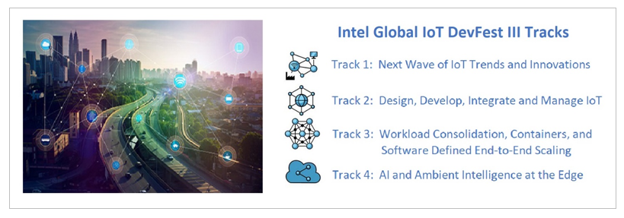
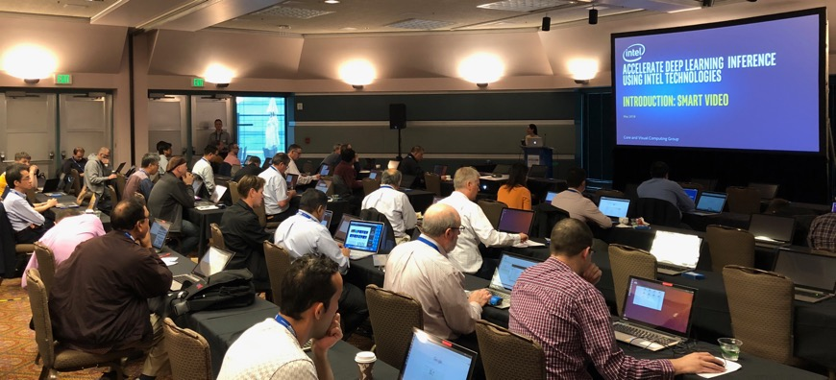
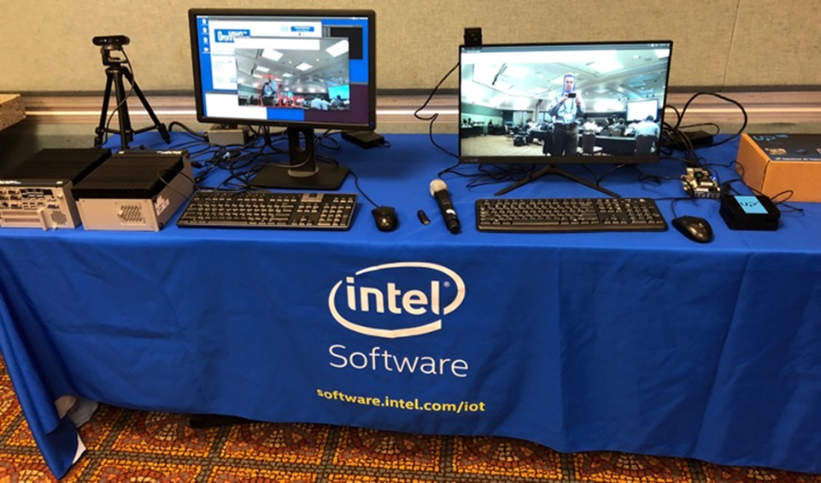
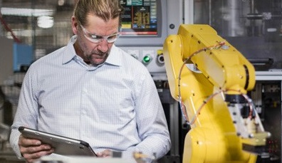
Engaging Through All Phases of Development
Events
Virtual/Tradeshows
(Global IoT DevFest)
Prototype
Productize and Scale
Define
Workshops
Hands-On Training
Promotion
Showcase Reference Implementations
IoT Innovators sharing Expertise
Engagements
ISV Engagement
App Enablement
Architecture Conversion
Notes:
Key Message: Beyond helping you accelerate development to deployment, Intel is engaged in understanding the IoT developers’ needs and challenges—from architecture to productization.

Slide 12
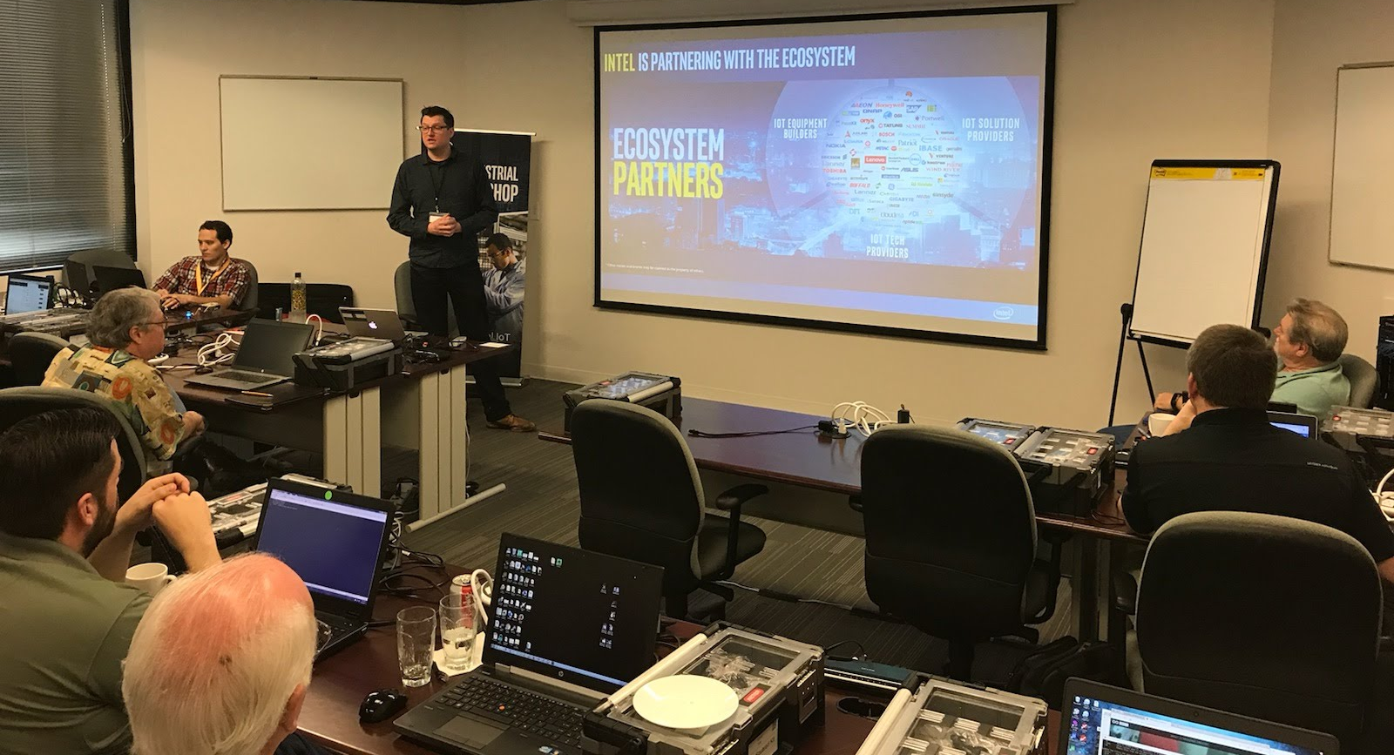
Industrial Workshop Overview
Introduction and
Intel Developer Program
Industrial Reference Implementations and the IEI* Tank Developer Kit
Building and Deploying Visual Industrial Solution on the Edge Insights Software Stack
Offloading Tasks to HDDL Accelerator Cards
Building and Deploying Time Series Industrial Solution on Edge Insights Software
Notes:
IIoT Workshop Overview
This slide gives a brief outline of the material covered in the Intel Industrial IoT Workshop. You can use this slide to give a quick overview of the topics and will be covered.
You can always find the latest course outline on Github.
https://github.com/SSG-DRD-IOT/Industrial-IoT-Workshop
Topics
Introduction to the Industrial Internet of Things and the workshop including:
Overview of the topics and the hardware
What is Industry 4.0?
What business opportunities and solutions will Industry 4.0 provide?
What are the key technologies that enable new value in Industry 4.0?
Continuous Visibility into business processes by deploying physical sensors and using analytics, digital twins and machine learning creates a Virtuous Cycle.
What Pilot Opportunities can your business begin to harness the Industrial IoT
Formalizing the IIoT – We will give an overview of the Industrial Internet Consortium (IIC) and create a architecture based on their whitepapers.
Physical Sensors and Actuators – We will explore the hardware sensors in the Up2 Grove IoT Development Kit and use Arduino Create to build a couple of sensor based labs
Communications and Protocols – We will talk about scalability in a IIoT network and three protocols MQTT, OPC-UA and DDS
Automation – Reactions based on sensor data
Smart Video System – the Intel CV SDK which includes OpenVX and OpenCV as well as the deep learning kit and the inference engine.
Machine Learning, Predictive Analytics, and Business Analytics will be written for the 2 day workshop.
Industrial IoT or Industry 4.0 has arrived at the doorstep many of the industrial companies and going forward high investment will flow into new digitalization processes changing the way the industrial ecosystem will operate. This workshops is an introduction in the concepts and formal architectures of Industry 4.0. The workshop is divided into modules. Each Module contains a lecture and a hands-on lab exercise that builds towards a test prototype of an IIoT infrastructure based on the Industrial Internet Consortium’s IIoT Reference Architecture and Intel technology.
In the second module, we will introduce a formal structure for realizing an IIoT deployment. The later modules fit

Slide 13
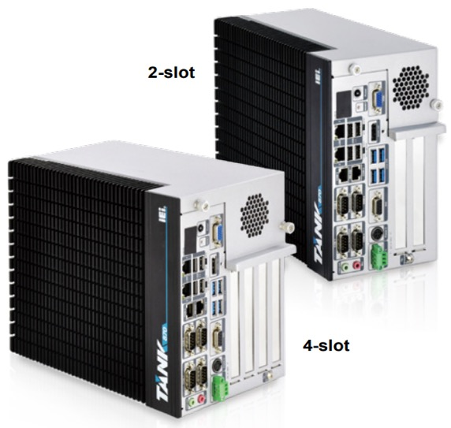
IOT Client (Core) Foundation Dev Kit
IEI Tank-870-Q170 (2-slot)
PCIe slots that will support HDDL-F (FPGA) and HDDL-RC (Myriad X)
http://eshop.usa.ieiworld.com/usa/items.php?CA=2&sub_CA=24
Specs:
Dimensions: 5” (121.5mm) x 10” (255.2mm) x 8” (205mm)
Weight: 13.9lbs (6.3kg)
Core i5 (Sky Lake at launch then convert to Coffee Lake Q4’18)
Kaby Lake Gen Gfx driver incompatible with CV SDK
Fanless
8GB of RAM
1TB HDD
2x PCIe x8
LAN1: Intel® I219LM PCIe controller
LAN2 (iRIS): Intel® I210 PCIe controller
WIFI/BT : Realtek RTL8821AE : 1T1R wifi module kit for embedded system, IEEE802.11a/b/g/n/ac WiFi with Bluetooth 4.0/3.0+HS, 1 x wifi module, 2 x 400mm RF cable, 2 x Antenna, RoHS
I/O Ports: 4x USB 3.0, 4 x USB 2.0, 4x RS-232, 2x RS-232/485, 8-bit DIO, 1x Line-out, 1x Mic-in
Operating Temp: -20°C~60°C
The IOT Client Foundational Kit will provide manageability, performance, and a scalable rapid path to market solution that will support advanced computer vision and deep learning usages.
https://software.intel.com/en-us/blogs/2018/06/13/introducing-the-tank-aiot-developer-kit

Slide 14
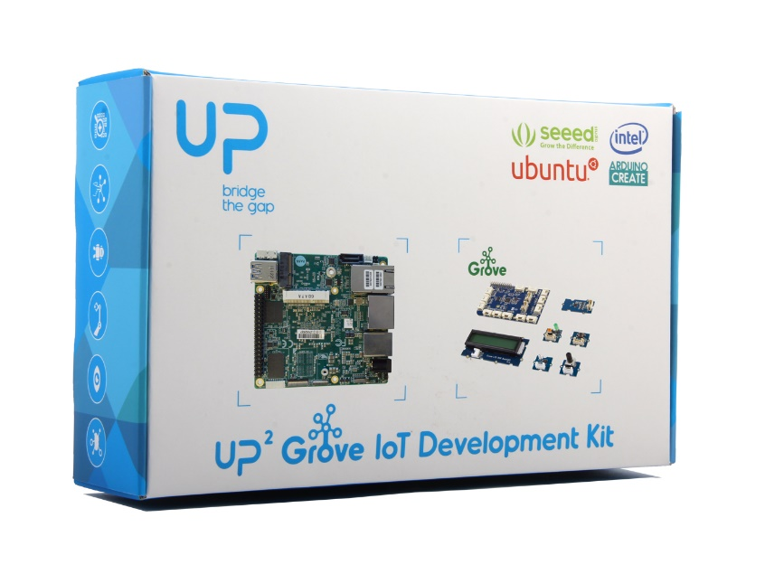
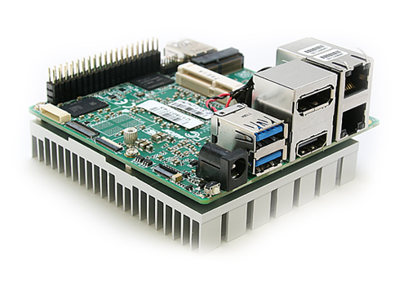
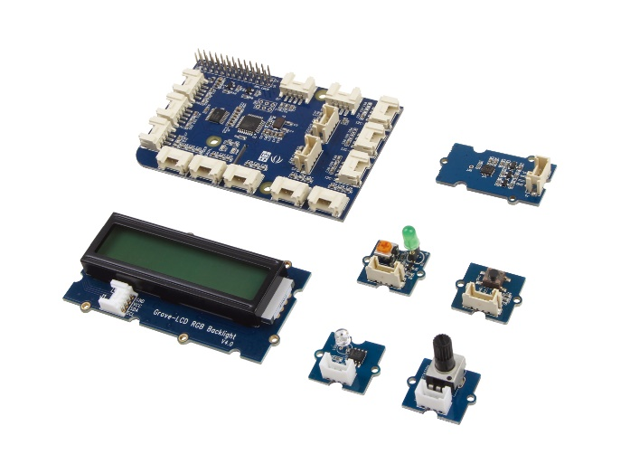
Introducing the Up2 Grove Iot Development kit
High-Performance Features
Fast CPU and graphics capabilities
Multiple displays, Dual network ports
Many I/O expansion options
Integrated Software
Preinstalled Ubuntu* 16.04
Over 400 sensor libraries
Integration for major third-party cloud providers
Development
Develop simply with Arduino Create*
Optimize code with Intel® System Studio

Slide 15
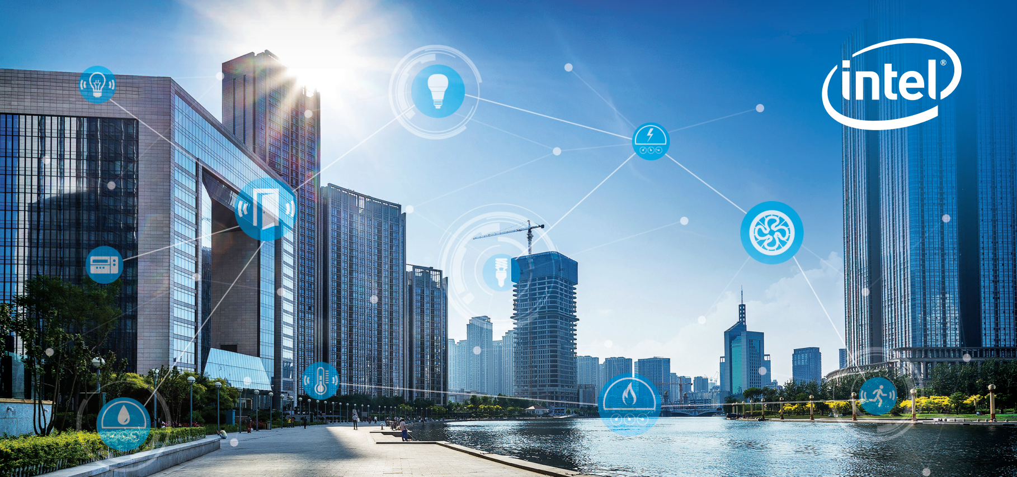
vision for Industrial IoT
Notes:
Intel is transforming from a PC company to a company that powers the cloud and billions of smart, connected computing devices. These devices will use the power of Intel technology to process data being generated from “things,” connect to and learn from data being analyzed in the cloud, and deliver amazing new experiences.
As the Internet of Things evolves, we see three distinct phases emerging. The first is to make everyday objects smart – this is well underway with everything from smart toothbrushes to smart car seats now available. The second is to connect the unconnected, with new devices connecting to the cloud and enabling new revenue, services and savings. New devices like cars and watches are being designed with connectivity and intelligence built into the device. The third is just emerging when devices will require constant connectivity and will need the intelligence to make real-time decisions based on their surroundings. This is the “autonomous era,” and machine learning and computer vision will become critical for all kinds of machines.
Intel’s goal is to lead the industry in transforming businesses and the way we live by making it simple to create exciting, new IoT solutions.
(source https://newsroom.intel.com/editorials/intel-acquires-computer-vision-for-iot-automotive/)

Slide 16
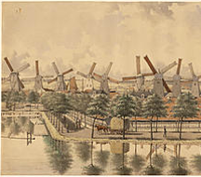

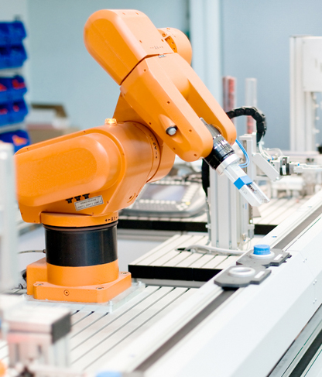

industrial Revolution 4.0
1st
2nd
3rd
4th
1760’s
1860’s
Late 1900’s
nOW
Steam, Water Mechanized Production
Electrification, Oil, Mass Production
Invention of the Microchip
Invention of the computerized network
Notes:
Industrial Revolutional 4.0
If you do a search for Industry 4.0, you will find many versions of a story that puts Industry 4.0 into a historical context of technological revolutions.
1st Industrial Revolution: This is what you were original taught in school and it was label as the “The Industrial Revolution.” Back in the 1800’s the steam and water power moved mechanical production and transportation. Sawmill, flourmills, mechanized butter churns and many automatic technologies for producing goods begin to appear. Interesting most of these technologies were based upon natural and renewable sources. They were also unfortunately limited to area that provided these resources. Mills were in a forest and next to the river that provided the power to turn a waterwheel, which turned crankshaft going into the mill, that was geared down to provide the mechanical power to needed cut, pounding, shredding, hacking or mixing raw material into tradeable product like paper and lumber and milled flour. Amsterdam became known for the windmill which even though the technology is considerably more advanced now, wind still powers the turbines and pumps that move hold the ocean back beyond the dikes of Holland.
2nd Industrial Revolution: The second industrial revolution begin with new chemical based methods of production. Instead of being next the river and using hydraulic potential energy, you could transport coal, oil and different chemical fuels and stores of energy to the location of your choice. Methods of transporting energy and products became more important and let to the train or then sometimes called the “iron horse”. This revolution saw and increase in the production of steel and also saw an increasing in inventive banking techniques. ended about 100 hundred years later and is defined as the era of mass production, famously exemplified by Henry Ford and his automotive assembly line. Mechanization also increased in the processing and refining of fuels and lubracants The goal was through division of labor here was to create many, many copies of the same product, reducing the cost and making the products available, affordably to many people.
3rd Industrial Revolution: Begin in the 1970’s when microprocessors because small, cheap and robust enough to aid in the automation of computerize manufacturing processes.
4th Industrial Revolution: Is this world of cyber-physical systems where the systems are connected and able to communicate with each other and also they are able to sense their environment and coordinate reactions with the state of the physical world. Parts, Part Distribution, manufacturing, assembly, distribution, dealer networks, OEM and though the lifecycle out to the customer themselves. This allows them to contribute to huge pools of information which big data and analytics can condense into actionable business actions.
The Internet of Things (IoT) comprises many emerging technologies that enable wireless interconnections among “things” (usually objects such as personal devices, appliances, cars, or industrial equipment, but also living things such as animals and people) equipped with data-gathering sensors. Early predictions indicate that the number of IoT devices could reach 26 billion worldwide by 2020 (Lee and Lee, 2015), but this estimate is likely to increase as more companies are jumping on the IoT bandwagon. One of the greatest predicted impacts of IoT is in industrial settings – where it will help transform entire industries by creating new opportunities for companies to manage their internal processes and interact with customers (Iansiti and Lakhani, 2014). These industrial IoT technologies and applications are denoted by the term Industry 4.0. Accenture predicts that collecting data from sensors placed on products, equipment, and even users, and using this data to improve processes inside and outside organizations “can add trillions of dollars to the global economy by 2030.” (Purdy and Davarzan, 2015).

Slide 17




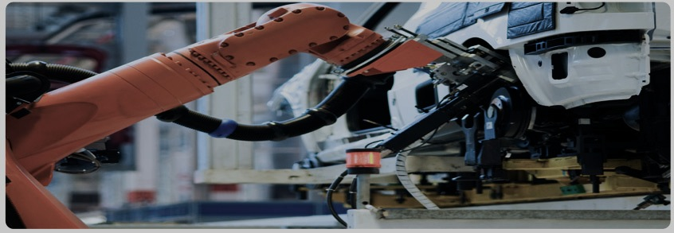

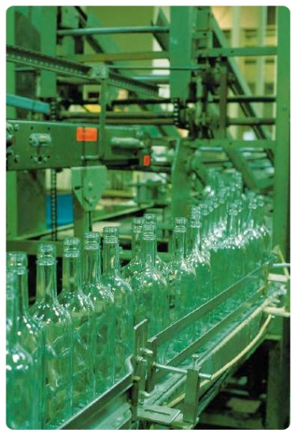

Industrial customers are asking …
How can I
capture knowledge for my transitioning workforce?
How Can I Better Innovate?
I need to improve
I need to achieve
Real Time
Visibility
How Do I
Improve workforce
productivity?
How Can I
How can I have better visibility to manage my
Introduce new IOT solutions faster?
Product
Quality.
How can I
Reduce
Downtime?
Global Supply Chain?
Notes:
Industrial leaders are digitizing essential functions within their internal vertical operations processes, as well as with their horizontal partners along the value chain. In addition, they are enhancing their product portfolio with digital functionalities and introducing innovative, data-based services. Both of these growth areas are starting with business increasing their visibility into the manufacturing, business and operating processes.
Visibility is the first key theme and the beginning of Industry 4.0.
At the end of this transformation process, successful industrial companies will become true digital enterprises, with physical products at the core, augmented by digital interfaces and data-based, innovative services. Both the vertical and horizontal value chains will be remade with software-defined, standards based, real-time, data driven solutions. These digital enterprises will work together with customers and suppliers in industrial digital ecosystems.
These developments will fundamentally change individual companies, as well as transform market dynamics across a whole range of industries. And that’s true in countries all around the world – in both the developed as well as the emerging markets.

Slide 18
Visibility Leveraged for decision making
“While manufacturers have long had access to data collected on the plant floor, it's typically been locked away in proprietary manufacturing software silos… That changes with IoT, which makes it far easier to collect and manage large amounts of manufacturing data… When paired with analytics, companies will gain better insights, allowing them to optimize plant operations, reduce quality defects and perform preventative maintenance”
- Matt Wells, product general manager for automation software at GE Digital
Matt Wells, product general manager for automation software at GE Digital, based in San Ramon, Calif.
Notes:
Here’s is a quote from Matt Wells, a product general manager for automation software at GE Digital.

Slide 19





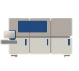
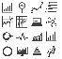

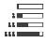


Industrial Edge Compute is Transforming
From This…
Proprietary, Specialized, Monolithic
To This…
Virtualized, Open, Interoperable
DCS
PLC
HMI
Robotics
MV
VM: DCS
On Prem Compute
(Edge to Fog)
VM: HMI
VM: PLC
VM: MV
Control
VM: MC
Machine
Sensors + Connectivity
Compute Node
On Prem
Data Center
Analytics
Analytics
enabled by Technical Pillars of Transformation
Virtualization
Security
Safety
Analytics (AI)
Machine vision
Real time
Notes:
Convergence is driving transformation in industrial IOT segments including manufacturing, energy, buildings, logistics. Similar to NFV and SDN for telcos.
Transformation on both HW and SW planes.
WC through virtualization is behind transformation.
Virtualization replaces purpose built devices; Intel offers many Si features such as Vt-D and Vt-X that allow for CPU, memory, and I/O voirtualization. In addition products like WR Titanium Control targets industrial segments and allows for consolidating traditional industrial control loops that could otherwise be challenging to integrate.
On the SW side, this convergence is also taking place. Multiple software programs -> one page of glass.
Six pillars of transformation -> heart of this convergence are what we call the six pillars of transformation.

Slide 20
Intel Technology for Industrial IoT/Industry 4.0
Open Platform
Interoperability
Performance at the Edge
Advanced Security
built with interfaces and APIs that enable integration with legacy systems and devices and with platforms from multiple vendors.
is designed into IA CPUs to offer backward compatibility to help SW and application reuse thus reducing development time and resources.
that enables near-real-time analytics, local decision making, and tighter process controls.
for trusted data from edge to cloud and protection from costly attacks.
Scalability
Manageability
Faster, More Flexible Deployment
for varying levels of gateway performance, with a broad range of support from Intel® Quark™, Intel® Atom™, Intel® Core™ and Intel® Xeon® processor D and E families.
for secure remote upgrades and services.
with a platform that supports your choice of operating systems and ecosystem applications.
Notes:
Why choose Intel -based technology for your solution?
First of all, it's an open platform. You're not going to be locked into proprietary hardware and software. It has interoperability with the existing assets you already own. It already will work with your data center and the software running in your data center because 98% of the data centers in the world run on Intel architecture. It enables significant performance at the edge so we can push compute so we can run analytics at the edge, which is a lower cost way to implement this solution. You get less networking and you get better reaction time.
Intel offers security from the hardware in the device, to the edge, to the cloud. You can embed the security in the hardware as well as the software that goes with it. Intel security solutions are constantly running analytics to look for threats and break ins – it’s a solution that not only protects, but also detects and corrects the security in the ever-changing world of threats.
The Intel system is scalable. We’ve proven that by scaling Intel architecture from personal computers to servers and data centers. The cloud scaled with it. The Internet scaled with it. And we can scale with IOT.
And Intel technology is built with manageability in mind. You already own software that manages an Intel-based system: you can reuse your asset. Your investment in people. You already know how to do this. Therefore you're going to get a faster, more flexible deployment.

Slide 21



Industrial IoT
Industrial processes are taking on a dual nature, one physical and the other digital.
Together Industry 4.0 runs on Cyber-Physical machines.
WHAT?
Sensors are connecting our tools to their physical environment. The Internet of Things is connecting our tools to each other, and large scale computing is connecting our tools to us through optimization of process and analytics.
IIoT is about decoupling devices from applications and gaining visibility into business processes. When each manufacturing device can provide data about it’s use and status then manufacturing processes can be dynamically configured and reconfigured by a data-driven, software processes. Manufacturing will be able to move faster, be more flexible, meet higher work safety standards and fulfill higher quality standards.
WHY?
How?
Working through Industrial Consortiums and Open Industrial Standards to connect current industrial processes to physical sensors, secure protocols, new safety standards, virtualization, real-time automation and machine learning will able visibility and optimization of current business processes.
Notes:
What
The term ‘Industry 4.0’ stands for the fourth industrial revolution. Other related terms include the ‘Industrial Internet’ or the ‘Digital Factory’, although neither takes as complete a view. While Industry 3.0 focused on the automation of single machines and processes, Industry 4.0 focuses on the end-to-end digitization of all physical assets and integration into digital ecosystems with value chain partners. Generating, analyzing and communicating data seamlessly underpins the gains promised by Industry 4.0, which networks a wide range of new technologies to create value.
The proliferation of IoT solutions, and the introduction of smart sensors in many diﬀerent verticals, has expanded the available data, and thereby increased the opportunities to derive benefit from predictive maintenance and asset monitoring. Real-time patterns in a collection of sensor output can predict the failure of a critical system or device. Automatically analyzing other sources of data, such as satellite imagery, can make for a secure and eﬀective infrastructure, such as an oil pipeline. Once a company in an industry implements these benefits, they gain an advantage over their competition. The other companies are left with the option to catch up, or to lose ground.
Creating smart factories generates many opportunities for operational efficiencies, asset tracking, and process improvements. But it also allows organizations to develop new products with greater efficiency and effectiveness, and get them to market faster and less expensively. OEMs can have a much better understanding of a machine’s life cycle and the way customers use them to ensure overall equipment efficiency, and to provide new, highly profitable services and recurring revenues through smart product features. Real-time machine information allows other organizations— financial institutions, insurance companies, consumables vendors, and others —to create new smart services and smart business models to maximize return on invested capital for the industrial assets, and the creation of new intangible assets.
Industry 4.0 encompasses 3 major topics
1. The Digitalization and Integration of the Vertical and Horizontal Value Chains. Horizontally, from their suppliers to their customers and vertically across the company from product engineering to manufacturing and service.

Slide 22
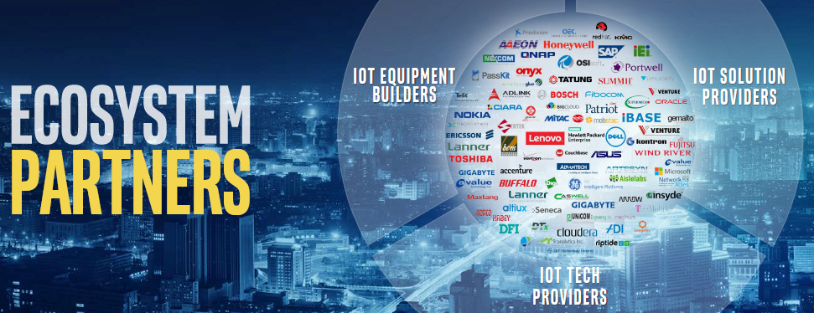

Intel is Partnering with the Ecosystem
* Other names and brands may be claimed as the property of others.

Slide 23

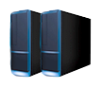
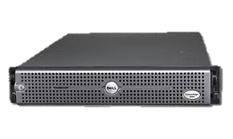
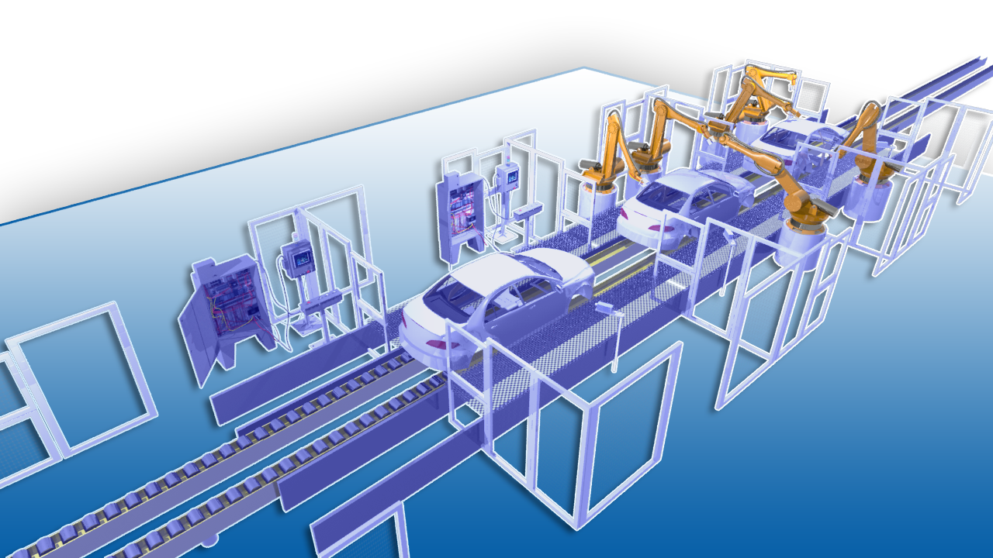
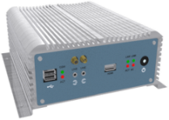
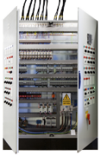
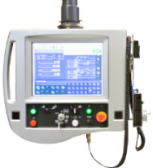
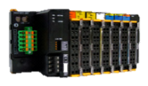
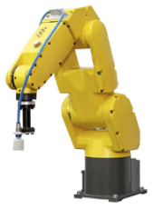
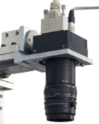


Intel ingredients in Industrial Automation
Data Center | Compute Performance I/O intensive
Factory server | Compute Performance I/O intensive
Industrial PC | Compute Performance Visualization/ UX RT Perf
PLC/PAC | I/O intensive Form Factor Sensitive RT Perf
HMI | Compute Performance Visualization/ UX Form Factor Sensitive
Remote IO | I/O intensive RT Perf
Robots | Compute Performance I/O intensive RT Perf
Machine visions | Compute Performance Form Factor Sensitive
Mobile workforce | Visualization/ UX Form Factor Sensitive

Slide 24
Case Studies
Intel and Industrial IoT

Slide 25
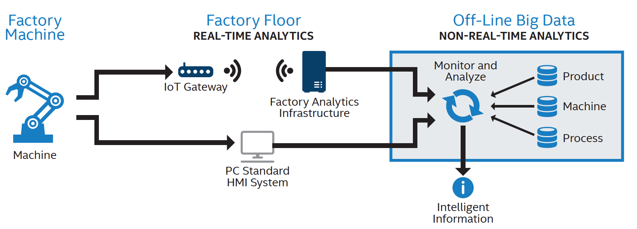
Intel Factory Automation
Pervasive Robotic Transport
Real-Time Excursion Control
Advanced MES & Decision Making
Predictive Maintenance
Remote Operation

Slide 26

Partner / Customer Device Management Account
API
CSP DB
CSP VM
Sensor Data
Dashboard
CSP Broker
MQTT Broker
CLOUD
Partner / Customer Device Management Account
Universal Wellpad Controller
securely and economically monitor and control oil and gas production facilities
API
Remote Mgmt
Over the Air Updates
GW Monitoring
GW Data
Production Pad Gateway
Containers
FIELD
Data Ingestion
LAMP
Data Report
Dev. Mgmt
3rd Party Control Software
Ethernet / Pv4/ TCP / TLS 1.2 MQTT
Ethernet / Pv4/ TCP / TLS 1.2 MQTT
Container Engine (Docker)
Pub Sub Message Bus (MQTT)
OS Services (Yocto with RT Extension)
AP/ Authenticator
Network Services
AS
Client Supplicant
Cellular (LTE / 3G)
WIFI (802.11ac P1)
USB
RS232 / 485
Ethernet (802.3)
bridge
ModBus Sensor 4
Modbus / TCP / 802.3 Cat 5E / 6 RJ45
ModBus (RTU/TCP)
Ethernet (802.3)
Wellpad
Sensor Hub
Sensor 1
Wired Serial Connection (UART to USB)
Sensor 2
Sensor 3

Slide 27
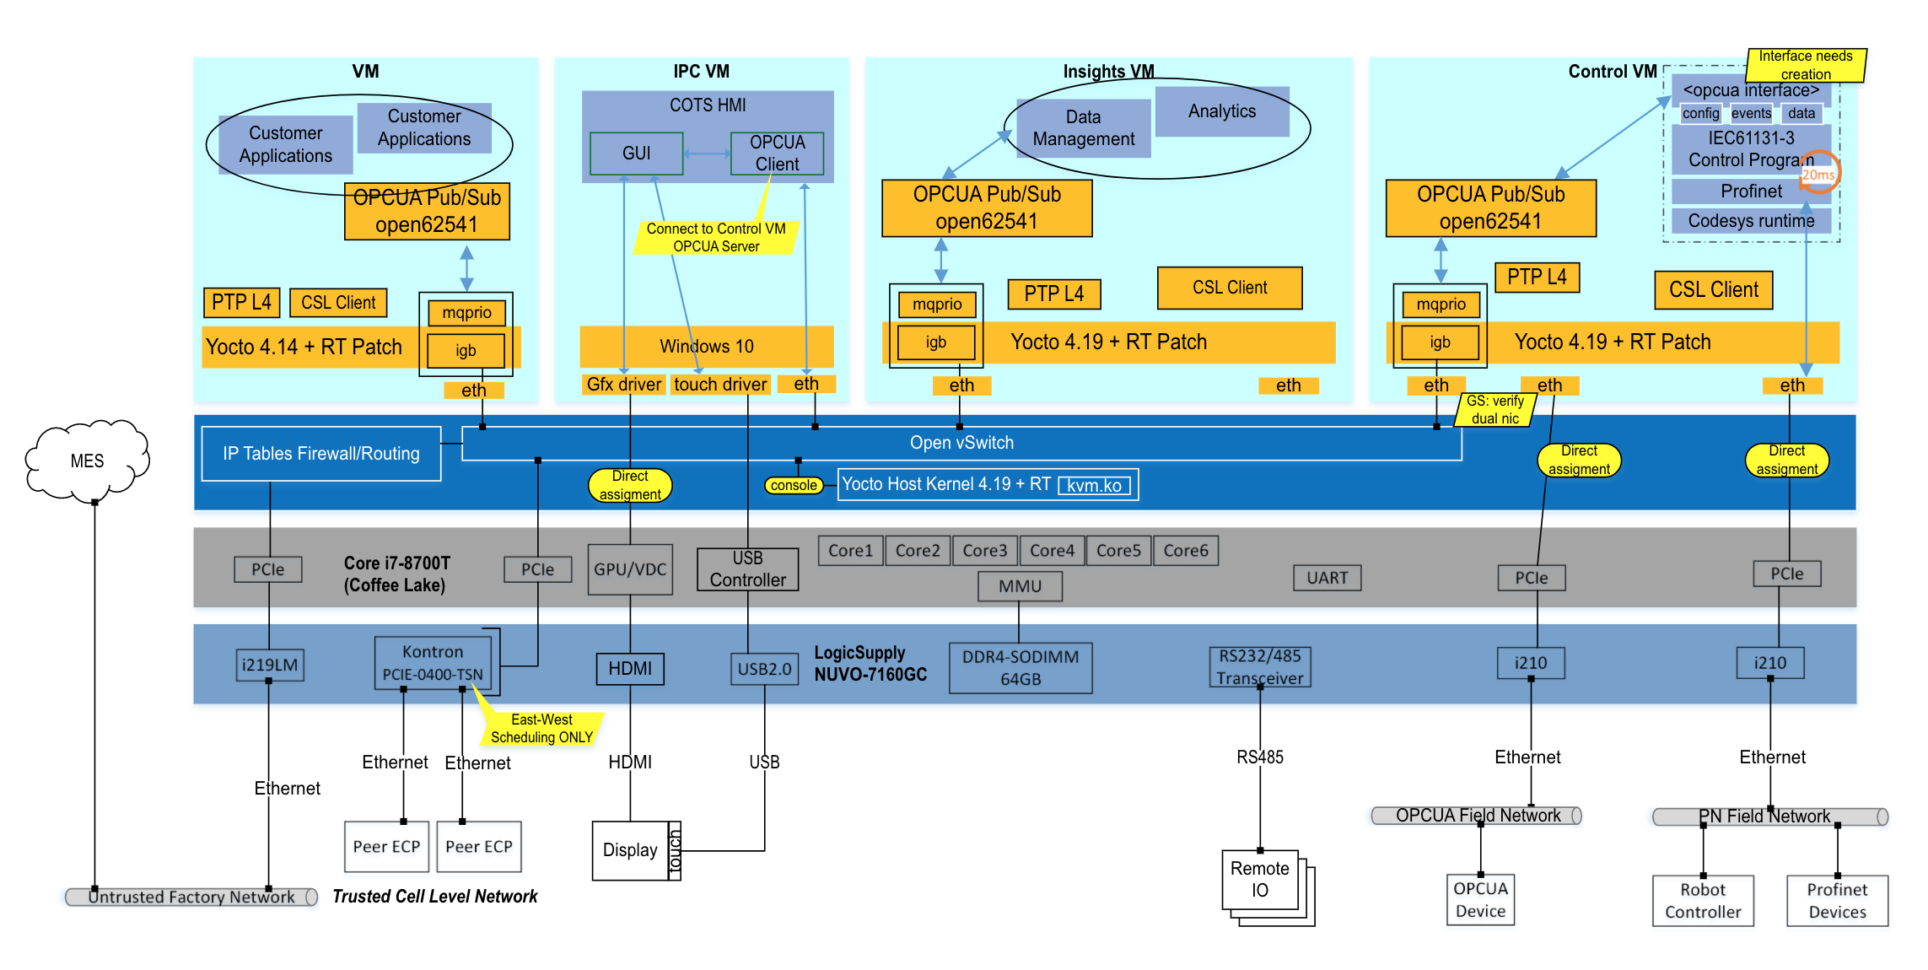
Intel Powered Manufacturing

Slide 28

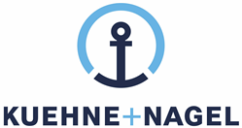

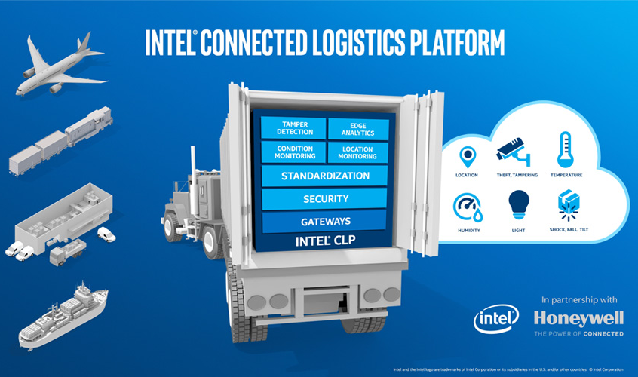
Honeywell connected freight
Asset Management
solution
Intel and Honeywell collaborate to develop 1st instantiation of Intel connected logistic platform through close partnership with key 3PL companies. The platform will deliver a cost effective and connected asset management solution.
Solution
Smart sensor tags with proprietary wireless sensor network
Intel based gateway with cellular and Wi-Fi connectivity
Analytics capability
End to end HW enabled security
Use Cases
Asset location tracking
Condition monitoring: Humidity, shock, tilt, fall, …
Logistic routing optimization
Speedier customs clearances
Customer satisfaction
Better forecasting
https://www.youtube.com/watch?list=PL6g2Y3N0CFAZUID8MIb48a33Lz3Hq0Y_8&v=zeRLY9ZanXA
*Other names and brands may be claimed as the property of others.
https://www.honeywellaidc.com/solutions/workflow/connected-freight-solution
Notes:
By Sahar/ Mauricio

Slide 29
Case Study Headlines
Fast Track IoT Smart Building, Industrial and City Solutions with Altiux and Intel
Altiux Helps Integrated Steel Plant Reduce ACC Energy Consumption by 18%
Altiux Helps Intelligent Glass Manufacturer Reduce On-site Maintenance Calls
Alleantia - Achieving the Power of Industry 4.0 with Plug-and-Play Simplicity
Intel Partner Simularity Delivers AI Software for Asset Monitoring
Cut Energy Costs with a Smart Real-Time Occupancy Solution from Feedback Solutions and Intel
The Infiswift IoT platform based on high-performance Intel® architecture enables more efficient agricultural operations.
Enabling data-driven insight and holistic visibility for Telco, service providers, and the enterprise
http://www.altiux.com/solution-brief-altiux-iot-and-intel.html
Notes:
This is an optional slide. Search for the whitepapers listed here if you would like to talk about this slide.

Slide 30
Intel Final Slide

